Slide 1
CONTEMPORARY WORLD (ASSIGNEMENT/REPORTING)
Submit by:
Garganta, Jericho
Quiano, Herminigildo jr.
Ramirez, Garry
Tavas, Nicole
Zingapan, Jamaica
Submitted to:
Sir. Jon Demelletes Jr.

Slide 2
Analyze how various media drive various forms of global integration.
This is hard to do, how can we look at the impact of various media drivers and integration. When there is a lot of activity and/or integrated activity, a way to help sort through this is to look at the downstream impact. So you don’t get too caught up in the nuance. An example is, measuring foot traffic in-store. And seeing trends in that versus the activity you had in the market. This doesn’t provide a perfect proxy but it does help demonstrate, or understand, what sort of impact the activity had in the market. Then test, each quarter, run limited experiments. Often people will rationalize these experiments to better uncover. Then roll them out globally or nationally.

Slide 3
2. Explain the dynamic between local and global cultural production.
Globalization’s contemporary omnipresence has resulted in an emphasis on the conflicts between the local and the global. This emphasis has blurred our ability to have insights that may be gained by recognizing that the local and the global are interdependent and cannot exist without each other.

Slide 4
Where did the musical act/artist originate?
Lea Salonga is the first Filipino artist to sign with an international record label (Atlantic Records in 1993). Salonga was the first actress of Asian descent to play the roles of Éponine and Fantine in the musical Les Misérables on Broadway.
In which countries did the artist become famous?
From starting her career in the Philippines, Maria Lea Carmen Imutan Salonga, also known as Lea Salonga, has made a name around the world.
c. How did the artist become famous?
Her rise to international fame began when she won Best Actress at the Tony Awards in 1991 for playing the lead role of Kim in Miss Saigon (1989-2001), making history as the first Asian actress to win this award for Broadway theater performers
d. Why do you think the artist became famous?
Multiple award-winning actress and singer Lea Salonga is renown across the world for her powerful voice and perfect pitch. She is best known for her Tony Award winning role in Miss Saigon. ... Many fans of all ages recognize Lea as the singing voice of Princess Jasmine from Aladdin and Fa Mulan for Mulan and Mulan.

Slide 5
The Globalization of Religion
3. Explain how globalization affects religious practices and beliefs
Globalization has spread religions, like Christianity, to places that it wasn’t before while simultaneously creating uniformity in how those religions are practiced by different geographically-distinct groups. There is a benefit, in that peoples around the world can further unify around a shared religion with common practices; however, as with globalization in general - there are drawbacks.
Religions may fade away as their practitioners are converted to newly introduced religions. Similar to the languages and cultures of some indigenous peoples; as the world becomes more connected in a shared dominant culture - those regional, more isolated and diverse cultures are overtaken and assimilated.

Slide 6
4. Analyze the relationship between religion and global conflict and, conversely, global peace
There is no evidence to indicate that particular religious’ traditions are, by virtue of their theology, more prone to violence or more likely to lead to conflict or peace than others. However, attention can and should be paid to the underlying and enabling factors that make it possible for individuals, religious or political leaders, or communities to embrace a religious discourse, symbolism or institution to carry out or justify violence. Simultaneously, it is necessary to remain intellectually flexible and cognizant of the fact that religion is not always relevant in conflict or peace dynamics.
Although it has been shown that religion can contribute to the escalation of conflicts, there is no fixed recipe for establishing which combination of actors, claims, external factors and religious features can ignite tensions and violence, where religious dimensions are central. Recognizing the role of religion and engaging with its multiple facets do not replace the work required to address the other interlocking issues (e.g. deprivation, marginalization, institutional malfunctioning, state failure, global dynamics of dependency) related to conflict and peace.

Slide 7
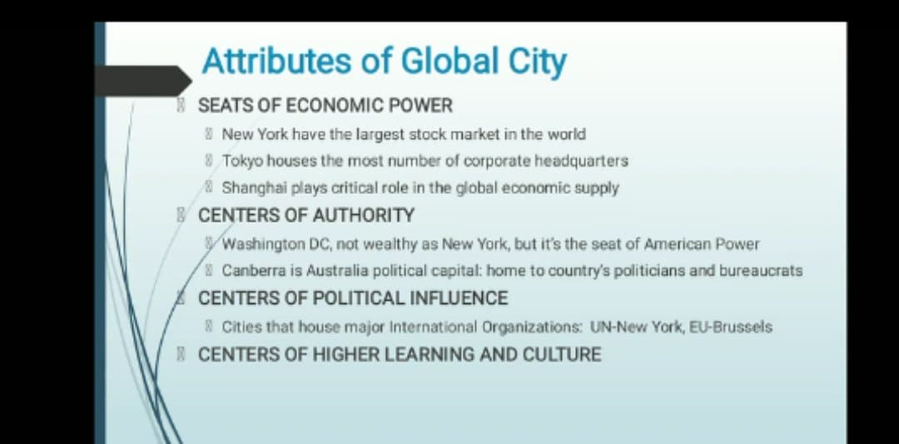
Global City
A global city, therefore, is the world's most important and influential city that covers the dimensions of the globalization. These dimensions are cultural experience, business activity, human capital as well as political engagement. There are several ways in which a city can be considered as a global city.
5. Identify the attributes of global city.

Slide 8
6. Analyze how cities serve as engines of globalization.
Globalization can be the process that is driven by different needs and purposes. It results in the increase in the flow and exchange of culture, information, people, money, services, and goods across geographical borders.
“Global cities” are and always have been both, products and producers of globalization. They play an important role in shaping a global economy, culture and society, but they are also shaped by it. And they are places where countervailing forces match and local reactions to globalization become especially visible.
‘Cities are productive engines of growth,’ Dr Clos says. ‘They bring economies of scale, develop markets, create jobs and encourage new economic activities to flourish. As economies move from primary activities such as farming, fishing and mining to industrial production and then on to services, the role of cities in the global economy increases with each transition.

Slide 9
The reporters should answer the following questions.
How would you describe your city?
I would describe Amsterdam as creative global city.
What is your city known?
Amsterdam also known have a quality of place, talented workforce, international focus, and technology hotspot.
Amsterdam’s talented workforce
Amsterdam rated highly due to the large number of knowledge workers in the city: the highest density of anywhere in the Netherlands, with 44 per cent of the population having some form of higher education. It’s also the largest Anglophone city on the continent, with 80 per cent of the workforce speaking English.
In terms of creative industries, the Netherlands ranks second in the world for "Creative Class membership," with 46 per cent of the workforce employed in creative occupations. That’s one of the reasons why the Netherlands was ranked fourth in the Global Innovation Index.

Slide 10
Dutch international focus
The Amsterdam area has a workforce drawn from 180 different nationalities from a population in which 45 per cent belong to an ethnic minority. The survey said Amsterdam was one of the least segregated cities in Europe and "a benchmark for inclusion and integration."
It also gave high scores for its support for LGBT citizens, its religious tolerance and civil rights, with an overall A on the "Tolerance Scorecard."
The Netherlands as a technology hotspot
As mentioned above, Amsterdam ranks on creative scores, sitting in the top five creative cities in the world, alongside London, New York and Los Angeles.
Another measure of creativity is entrepreneurship: according to the Global Entrepreneurship Monitor report, the Netherlands is the most entrepreneurial country in the EU, with 7,2 per cent of Dutch citizens between the ages of 18 and 64 owning or planning their own start-up.
The Amsterdam region also has the world’s largest, most stable digital exchange platform, which has been a major draw for ICT companies from around the world.
The city has around nine "knowledge-clusters" geared towards the ICT and Life Sciences industries that aim to consolidate the efforts of organizations and create strong links between knowledge and business development.

Slide 11
Quality of Place
Amsterdam also scored an A for amenities, which included rating museums, cultural events, and entertainment and nightlife.
The survey gave especially high scores for investment in architecture, the variety of "scenes," or separate cultural identities, and, naturally, bike paths.
This rating mirrors that found by the Economist’s Liveability Ranking, which ranked Amsterdam as the world’s second-best city in its spatially-adjusted version of the famous survey.
What make your city a global city?
Since the 17th century the city has been known for its liberal thinking and tolerance
It encourages its many visitors to explore beyond the city centre by branding and promoting its neighborhoods
Increasingly cultural policies and activities in Amsterdam have a broader citywide and regional scope, rather than being concentrated around one area.
Amsterdam is a typical ‘global city’ with a large service sector that employs professionals from all over the world while Rotterdam is best characterized as a post-industrial city, where low-skilled workers of native and immigrant origin compete with one another. This difference is reflected in the cultural and political life of the two cities and also in their diversity policies.

Slide 12
7. Explain the theory of demographic transition as it affects the global population
The Demographic Transition Theory is a theory that sheds light on changes in the rate of birth and death, and thus on the population growth rate.
The birth-rate and death rate rates are different, along with economic growth. The growth rate of the population is also different because of it.
“Demographic transition refers to a population cycle that begins with a fall in the death rate, continues with a phase of rapid population growth and concludes with a decline in the birth rate”-E.G. Dolan.
According to this theory, economic development has the effect of bringing about a reduction in the death rate.
With economic progress, the relationship between birth and death rates shifts and a nation has to move through various stages of population growth. C.P. Blacker divided the population into five types as high, stationary, early expanding, low stationary, and diminishing. According to the theory of demographic transition, during the process of economic development, population growth would have to move through these distinct phases.

Slide 13
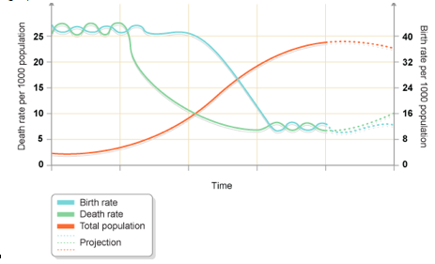
Stage 1:
This was pre-industrial times - 99% of recorded human history - where death rates were very high, and birth rates had to match/be higher than death rates to sustain the population.
The birth rate is very high due to universal and early marriages, widespread illiteracy, conventional social values and customs, lack of knowledge of family planning strategies, attitudes towards children to augment the family income, etc.
At this stage, Death rates are also high due to inadequate diet and lack of adequate medical and sanitation facilities. In this economy, the population growth rate is not high as a high birth rate is compensated for by a high death rate.

Slide 14
Stage 2:
With the gradual achievement of economic growth, people's living standards began to improve due to better and more frequent diet, improved medical and sanitation facilities leading to a decrease in the death rate.
Daily food supplies, better law and order conditions, medical advances and advancements, the production of antibiotics, vaccines, and the implementation of immunization programs have contributed to a major reduction in the occurrence of disease and death. But at this stage, the birth rate continues to remain very high in-spite of a substantial fall in death rates leading to the accelerated growth of the population.

Slide 15
Stage 3:
During the industrial era, if we're speaking about the global population, during which incomes rose and families moved into cities. This urbanization required less human capital, so the total population finally began to stabilize.
It is also defined as a demographic stage since the population continues to expand at a rapid pace. At this point, the birth rate decreases more rapidly compared to the death rate. As a result, the population is rising at a decreasing rate. This stage is characterized by a decrease in the birth rate, although the death rate remains stable because it has already fallen to the lowest minimum. Birth rate reductions due to the effects of economic growth have modified social perceptions and expanded facilities for family planning. As the death rate stops decreasing, the population continues to rise exponentially, while the birth rate, while diminishing, remains higher than the death rate.

Slide 16
Stage 4:
It is called the stage of a stationary population. The birth rate and death rate are both poor and close to balance again. The birth rate is nearly equal to the death rate and there is no increase in the population. It's becoming more or less stationary at a low level.
Has the Philippines undergone the Demographic Transition? Why or Why Not?
The Philippines has undergone a demographic transition. The Philippines’ population is changing from one that has high fertility and high mortality rates to low fertility and low mortality. It will result soon in a demographic profile of the Philippines that will shift from having a lot of dependents to having more workers and fewer dependents. The economist predicted that the Philippines can be the 16th largest economy by the year 2050. Demographic transition has 4 stages.
the first stage of demographic transition is called the pre-modern stage wherein there’s a high birth rate and high death rate. The birth rate is high because of illiteracy, and the high death rate because most of the people during the pre-modern stage are poor. So they can't afford to have a proper life at that time.

Slide 17
Global Migration
is defined as, a situation in which people go to live in foreign countries, especially to find work, from developing countries to developed ones (Cambridge Dictionary).

Slide 18
8. Analyze the political, economic, cultural, and social factors underlying the global movements of people
The first level of explanation--the individual or the psychological--focuses on individual perception and asks what advantages individuals hope to obtain by migrating. These often include the prospects of increased economic opportunity or a higher standard of living or escape from social turmoil. A second level of explanation focuses on family needs. Often, the decision to migrate is not simply a personal but a family decision, reflecting the desire of a larger family unit to enhance its security or improve its well-being. Many family or kin groups receive "remittances"--cash payments that help to support family members--from relatives who have migrated to another area.

Slide 19
A third level of explanation--the structural and institutional--focuses on the broad social, political and economic contexts that encourage or discourage population movement. Factors that stimulate migration include improvements in transportation and communication or income differentials between more economically advanced and less advanced areas. War, too, often induces migration. Factors that inhibit migration include immigration laws restricting exit or entry or laws or social practices that tie farmers to the land (such as sharecropping or debt peonage which prevented many african americans from leaving the post-civil war american south).
Push factors: factors that repel migrants from their country of origin--include economic dislocation, population pressures, religious persecution, or denial of political rights.
Pull factors: factors that attract migrants to move, including the attraction of higher wages, job opportunities, and political or religious liberty.
Uneven development: disparities in income, standards of living, and the availability of jobs within and across societies.

